Slide 1
Student | Getting started with youHQ
Professional wellbeing software for schools bought to you by Life On TimeTM

Slide 2
youHQ is uniquely changing the way schools care for their people by incorporating effective mood and wellbeing monitoring with therapeutic CBT-style tools.
WHAT IS youHQ?
WHAT CAN IT OFFER?
The app is a new way you can reach out if you need support. It has lots of tools and resources to help you live your best life.
Allows students to self-reflect
Gives teachers the insight to identify those students who need support
Gives students therapeutic tools to self-care
Learn about values Understand what matters most to you
Create a plan
Set goals towards a fulfilled life
Get prepared for greatness
Learn personal development and wellbeing skills
Make it personal
Customise your
own avatar

Slide 3
Introduction
https://youtu.be/HGUhoSSbFXI

Slide 4
Session 1 Log in + Mood survey: https://youtu.be/0GDt0Xv6ImY Session 2 Set Values and Support feature: https://youtu.be/pp0lvhwdmR0 Session 3 Set Goals and Actions linked to Values: https://youtu.be/aFiTAtFkwZs Session 4 Avatars and Dashboard: https://youtu.be/lXszjsXIH50 Session 5 Achievements and GOALd: https://youtu.be/jTUkqzKW6Q0 Session 6 Snapshot, ideas and competition time: https://youtu.be/4tL3BqyMfI8
QUICK VIDEO LINKS – Student sessions

Slide 5
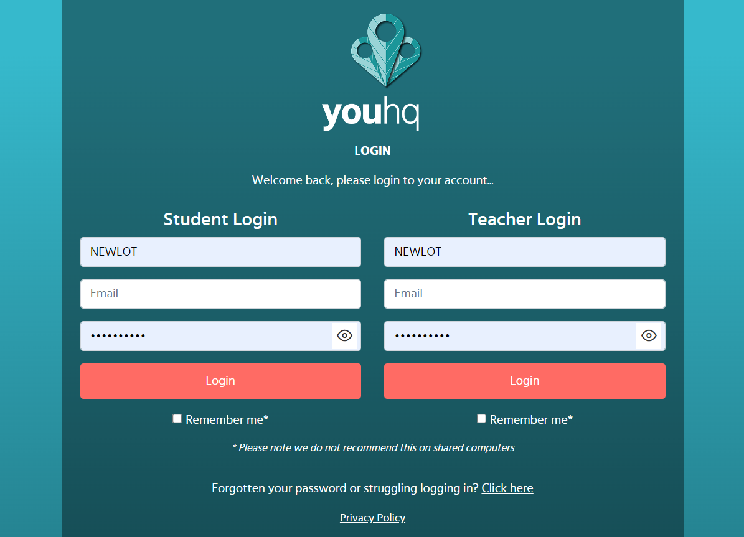
HOW TO LOG IN + SURVEYS https://youtu.be/0GDt0Xv6ImY
Log in
Receive email from ‘LifeOnTime’ (the parent company of youHQ) - check your junk folder
The email will contain: - Link to youHQ - School ID - Password
Click on the link in the email or if you are using youHQ as an app on your device, open the app and enter the details as they appear.
If you copy and paste the password make sure there are no spaces or it won’t work!
First log in
The very first time you log in you will be introduced to the ‘Goal Genie’ – despite it’s name it will walk you through an intro to youHQ as well as how to set goals and introduce values.

Slide 6
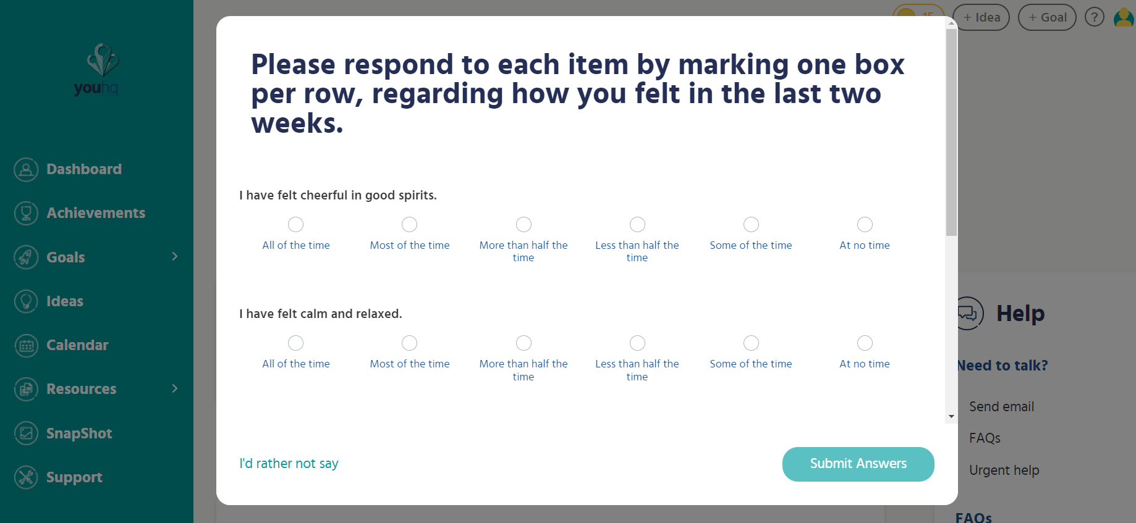
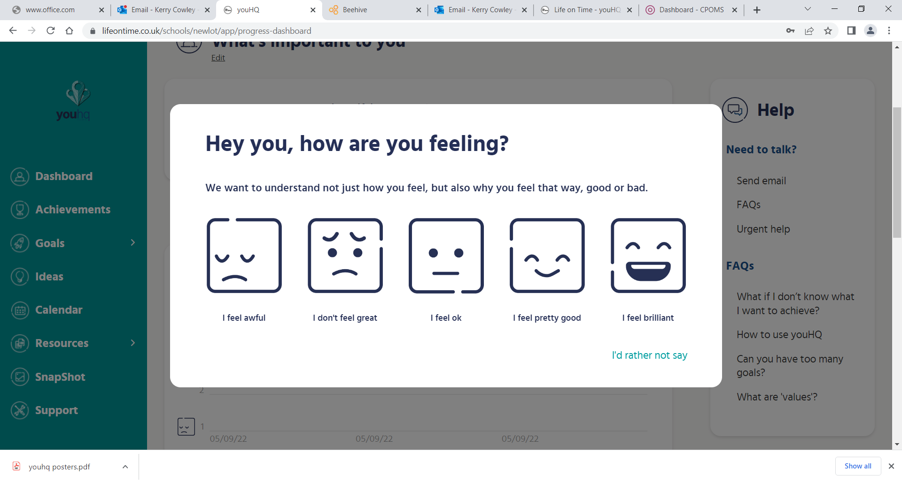
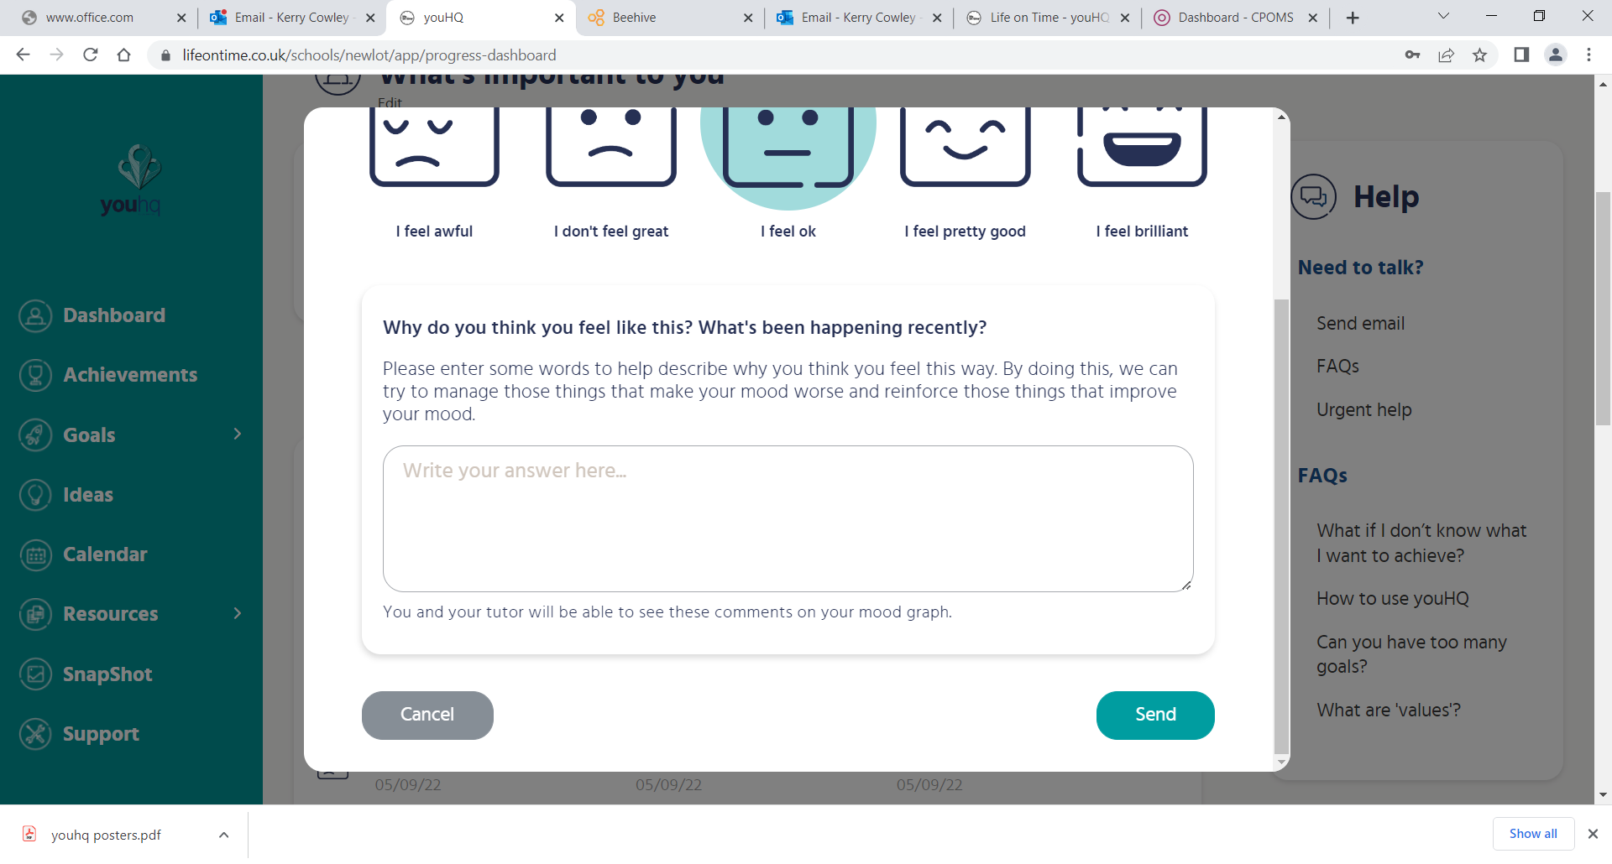
NOTE: Please be aware that all information on youHQ will be monitored by your teacher and Head of Year. As a school we have a duty of care to ensure you are safe and happy.
Surveys
After the Goal Genie, or if you’ve clicked to skip it, youHQ will launch two surveys; WHO-5 (World Health Organisation, 5 question) and Mood emoji check-in.
Complete the WHO-5 wellbeing survey.
For each question select the most accurate answer from “All the time” all the way to “at no time”.
It’s important you are honest. Remember, this is not a test.)
Mood Survey
Emotional Intelligence is a skill that improves your mental fitness (many adults struggle with this). If you can develop this now it will help you mentally in the future.
When this is done the ‘mood check-in’ will automatically appear.
Select the mood emoji image that best reflects how you are feeling right now.
Think about a possible reason why you might be feeling this way. This is called emotional intelligence.
You may will then be asked to explain your feelings, if you feel able to do this, it will support us in being able to help you (if you don’t feel able to share why, that is ok as well).

Slide 7
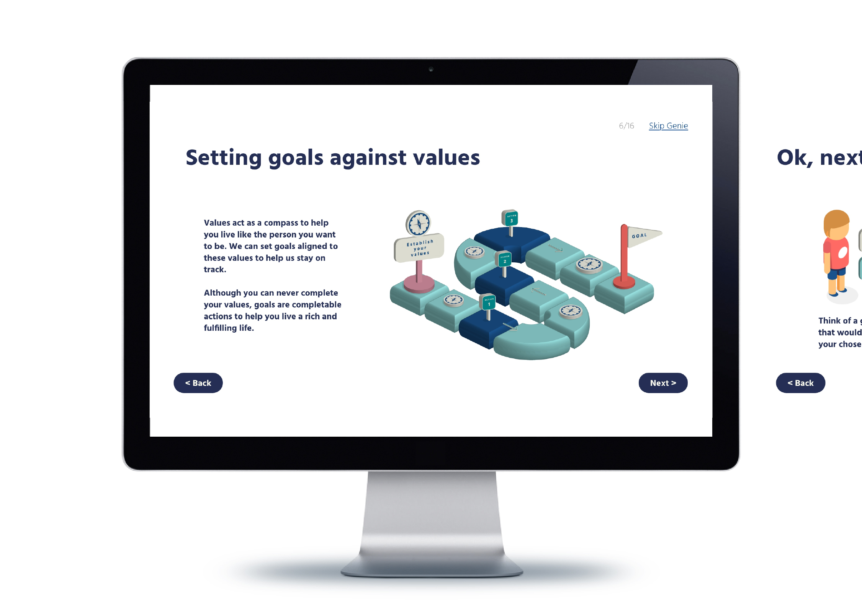
GOAL GENIE
The Goal Genie is a 25 page interactive slideshow that introduces you to the youHQ platform.
It appears automatically the first you log in but can be reached from various access points within the app.
You will lean about why youHQ asks for certain information; what values are; how to set goals and actions towards these values; and how to earn GOALd
Importance of values
It’s important to learn what you feel matters to you most. We call these ‘values’. By learning about these values you can start to live your life towards your definition of success.

Slide 8
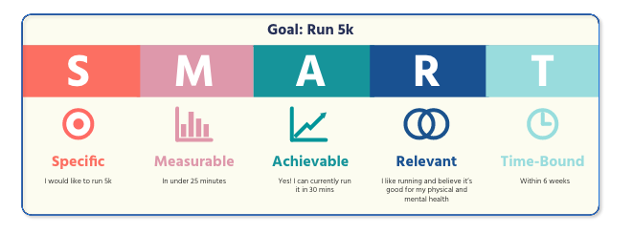
NOW IT’S TIME TO SET GOALS
When we set goals its important they are specific to us, that they are measurable in some way, achievable and realistic with a time frame that’s going to ensure it continues to motivate us.
Whilst the value acts as the compass point, the goals aligned to these values form way markers that help us stay on track. These can form smaller daily habit-based goals, or medium-term and longer-term goals.
Reflecting on these goals and other moments aligned to my values, you can develop a contentment and satisfaction that you’re living true to yourself and how you wish to engage with others.
Did you know
People who write down their goals are 20% more successful in accomplishing them than those who did not

Slide 9
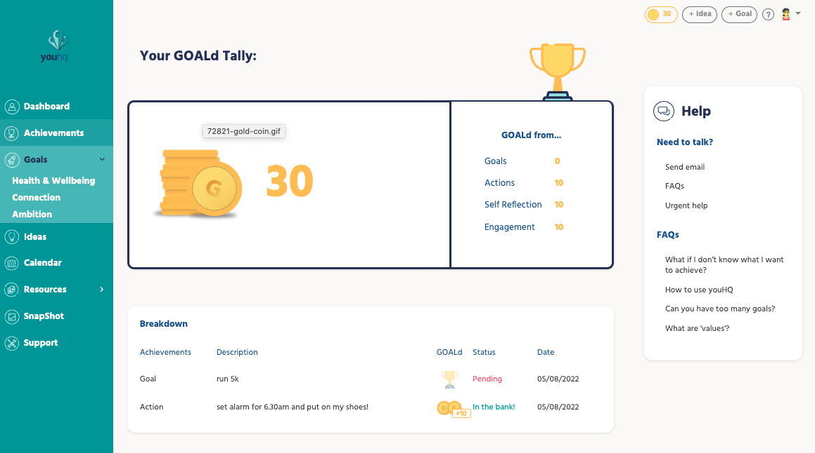
FORMING POSITIVE HABITS WITH GOALd
Each time you log in and complete a task you will receive GOALd points. GOALd is rewarded for: - Setting an Action - Setting a Goal - Completing a goal - Completing the genie
Look in your ‘Achievements’ section to see how much GOALd you’ve earned.
You can spend your GOALd on making your Avatar even more like you!
GOLD points will be linked to rewards points at the end of each half term.
Watch this space
youHQ is developing more ways for you to spend GOALd so stay tuned. In the mean time, try to rack up as much as you can :)

Slide 10
BENEFITS OF youHQ
Learn new habits to live your life towards your definition of success.
Open lines of communication with your tutor
Keep a record of your own mood over time and why you felt the way you did.
Share your mood with your tutor – support is on offer
Provides a time to pause to briefly reflect on your own feelings
Access to instant support using resources: online videos/links
Identify areas in your life that need more support
Learn new skills to improve mental fitness

Slide 11
NEXT STEPS
You will receive a log in – click on it
Download the app and log on
Log on every week to show your mood, use the resources …

Slide 12
FAQS

Slide 13
FAQS
Q. I can’t login?
You can login either on your mobile app (downloadable from app store) or on your PC/tablet mobile through the link/s your school/lifeontime will have sent you.
For the mobile App - You will need your;
school ID
email
password
To login in on a desktop you will need to click on the link which should have been sent to you by your school and you will then need to enter your;
email
password
If you can’t login because you’ve forgotten your password you can re-set it by clicking the ‘forgot my password’ link on the login page. Simply type your email address in and you will receive new login details direct to your inbox (check your junk).
If you have lost or forgotten the link or school ID please email info@lifeontime.co.uk or your school staff lead and they will send you a reminder.
Q. What does connection, ambition and health and wellbeing mean?
These are the areas of life the goals are associated with. For example if you plan on becoming fitter this would fit under the health and wellbeing area. If you want to set a goal around a subject at school or a career this would sit under ambition. If the goal is to do with your relationships to your friends or our environment the goal would fit under connection.
Don’t know what to set as a goal?
This is common as you may not know what you want to achieve or how to articulate it. If this is you, it’s often best to start with the ideas section. Ask the following questions to tease out some aspirations;
Do you have any ideas of things you want to try and achieve in the future?
What type of thing do you enjoy doing the most and is there anything you can do to make you improve at it?
Is there anything at school or at home you want to improve at?
Have you thought about any acts of kindness you could do to make someone else feel good?

Slide 14
FAQS
Q. What is a good goal/action?
A good goal is something that aligns to the students or schools values and follows the SMART goal setting process
S – Specific Is the goal or action specific. For example to be better at maths is not specific but to get 70% or higher in the next maths test is.
M - Measurable Can the goal or action be measured? If the goal is to be better at maths it’s difficult to measure but setting a percentage in a test or piece of homework can be.
A – Achievable Is the goal achievable? If you aren’t sure, you could ask the student to scale 0-10 (0 being really easy, 10 being super challenging) how achievable he/she thinks the goal is – if it’s above a 6 then you could recommend they make it easier.
R – Relevant Is the goal relevant to the student and the values of the school/student? If the goal is to go to University because their parents want them to but their not sure then this may not be a good goal as its not relevant to the individual.
T – Time Framed Is the goal or action time framed? For example, has the student set a time limit to achieve the goal? The youHQ calendar manages this so they can pick a date for when they want to achieve it and change this at any point.
Q. Is there such a thing as a bad goal or a goal I should be concerned about?
If a goal isn’t a SMART or suitable goal, then the goal can end up working against us. If you are concerned about a goal, please set up an 1-2-1 with the student, ideally in a quiet place and individually, not as part of the class.

Slide 15
youHQ.co.uk

